Slide 1
Computational Techniques for Genomics Project option 2
Chuwei Xia

Slide 2
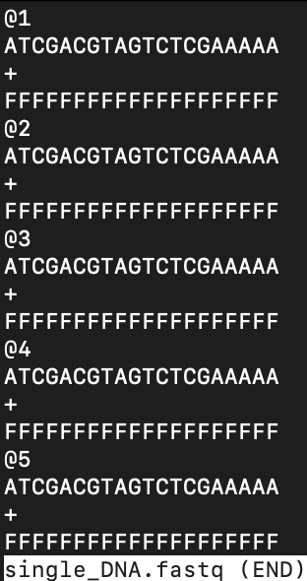

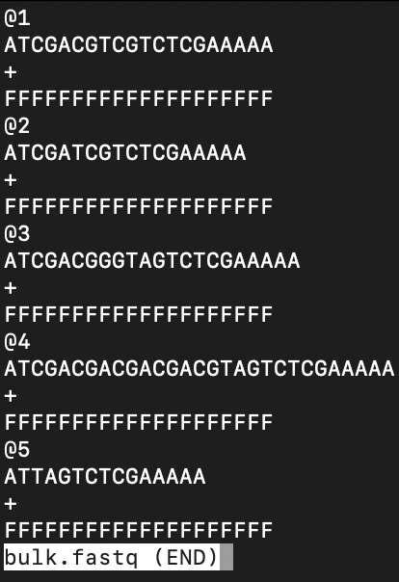



Basic knowledge
Ideal situation:
Real situation:
amplify
sequencing
amplify
sequencing

Slide 3
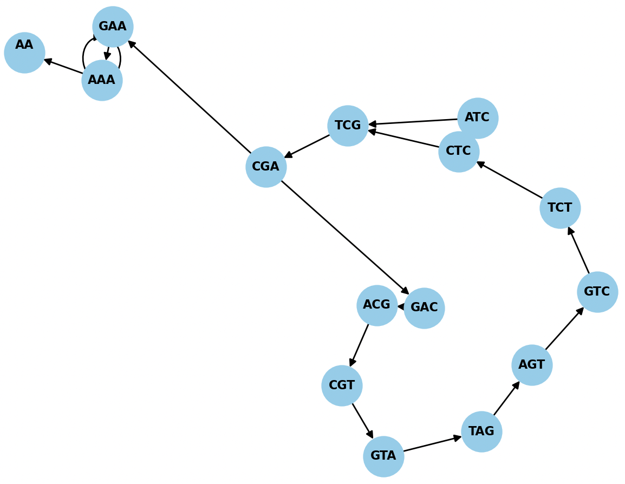
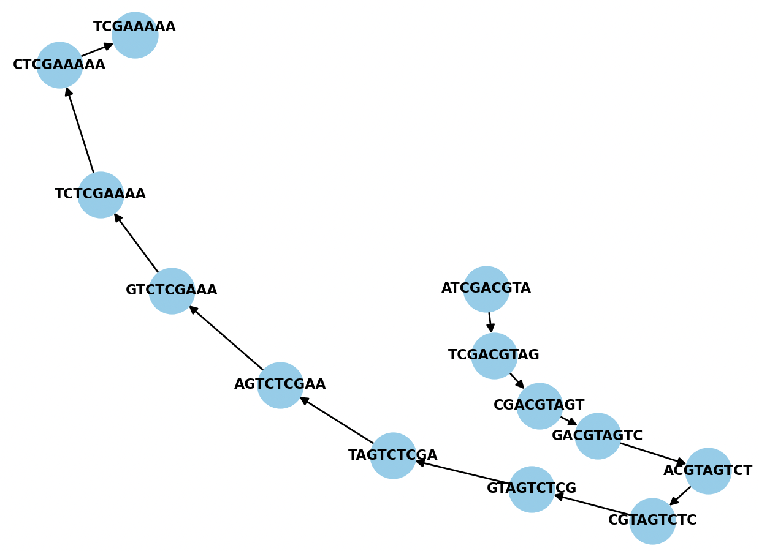
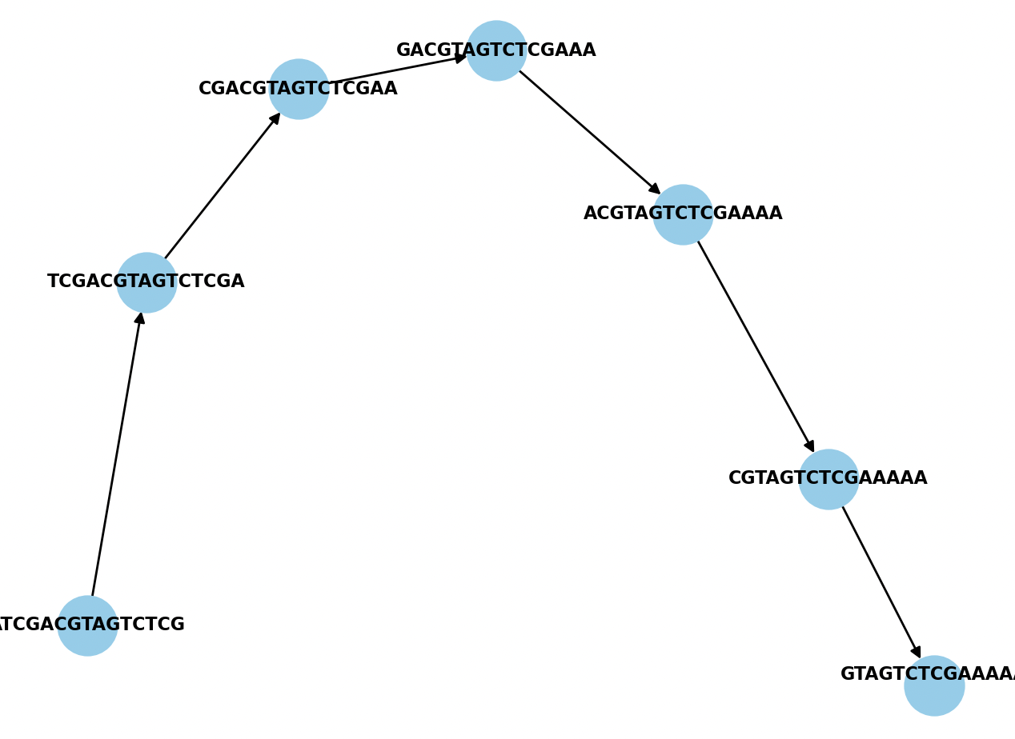
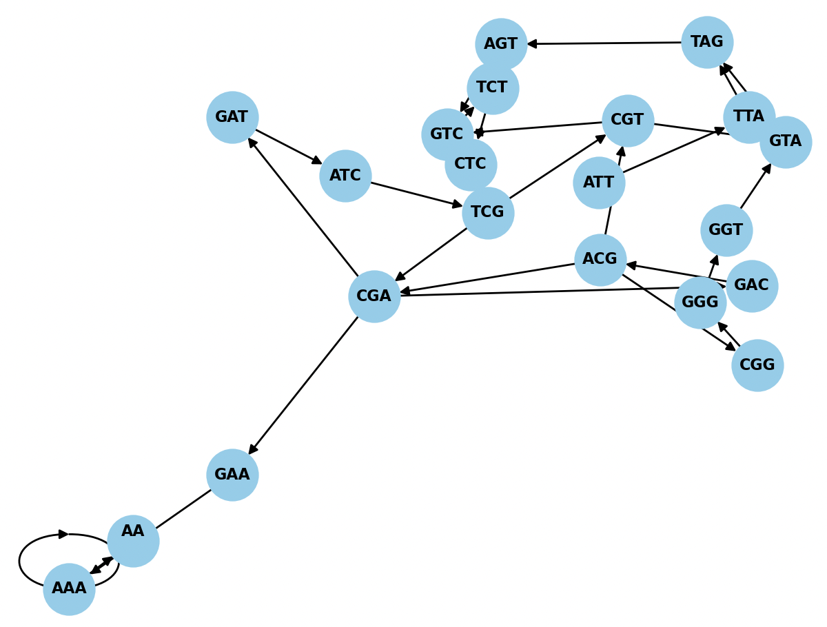
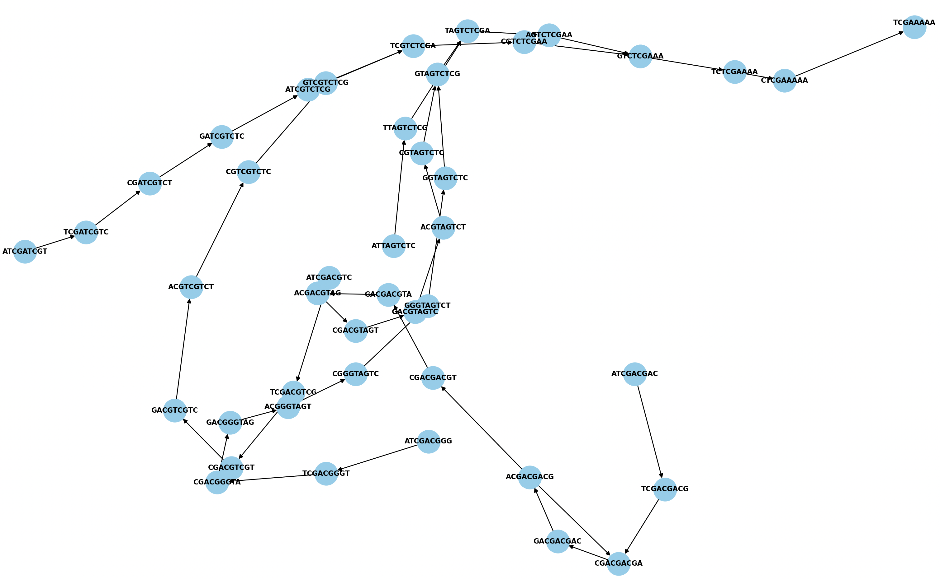
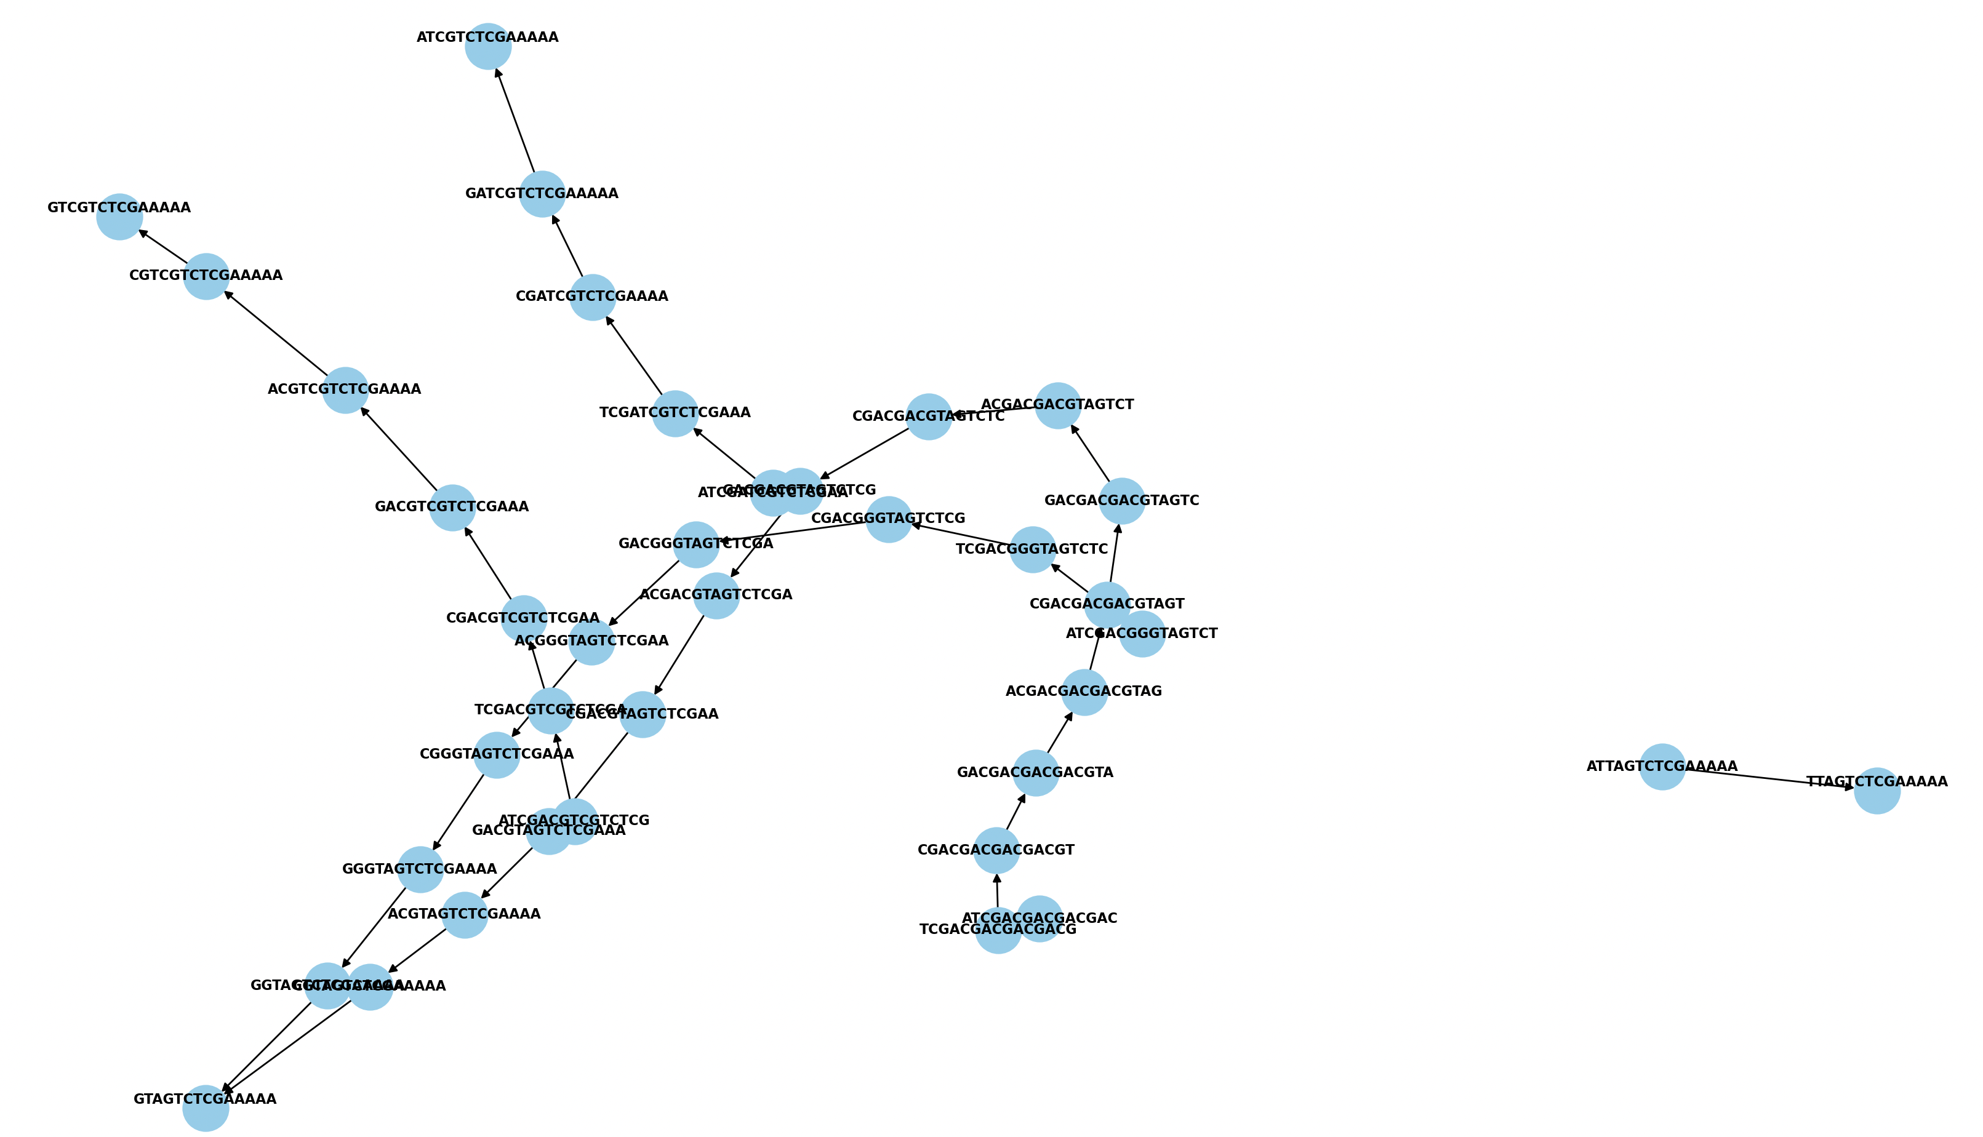
Basic knowledge
K=4 K=10 K=16
Ideal situation:
Real situation:

Slide 4
What happens in real situation?
Duplication
……
Insertion
……
deletion
Truncation/mismatch

Slide 5
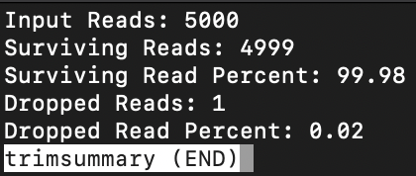
Workflow
Quality control & filtering
Sars fastq data is single end, using phred33 coding.
Removed low-quality bases from the beginning (5' end) and end (3' end) of each read until a base with a quality score of at least 3 is encountered.
Performed sliding window trimming. It scanned the read with a 4-base-wide window, and trimmed when the average quality within the window drops below 15.
Discarded reads that were shorter than 36 bases after trimming.

Slide 6
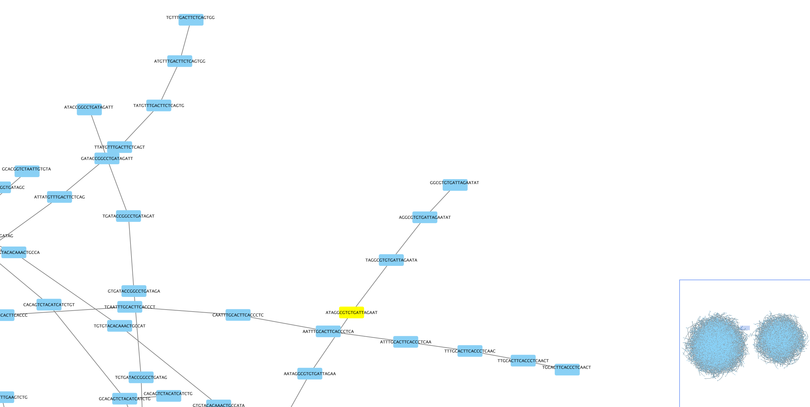
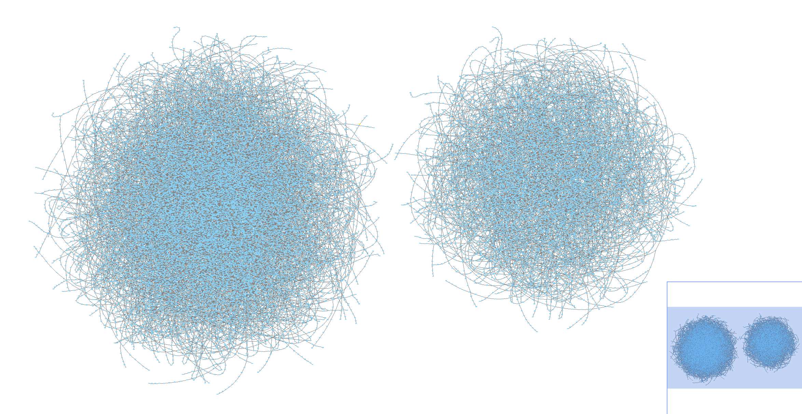
Workflow
Create the De Bruijn graph
Set kmer length=20, visualize using Cytoscape:

Slide 7
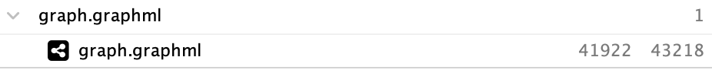
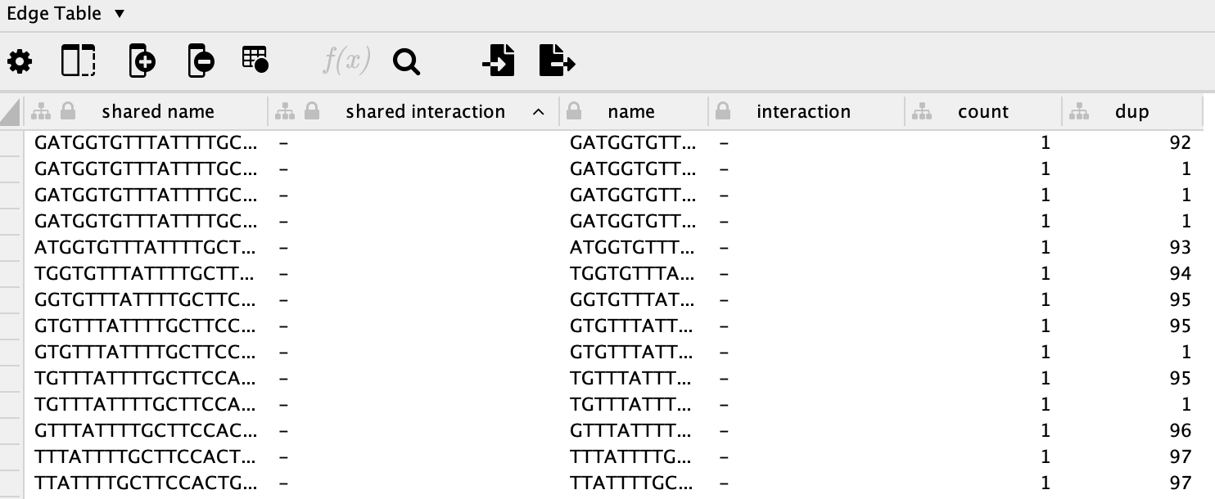
Workflow
Store the duplication times of each edge
Though looks like hair balls, this graph is a sparse graph with 41922 nodes and 43218 edges.

Slide 8
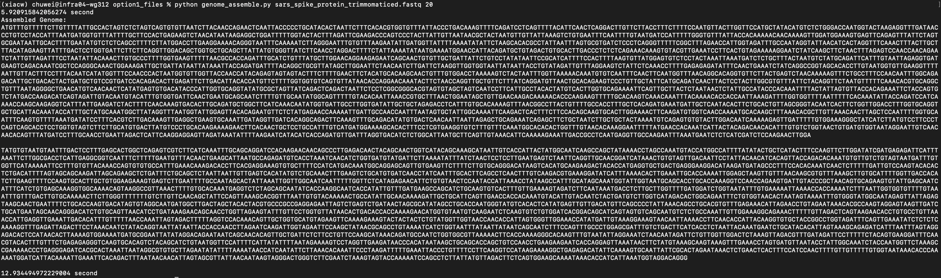
Workflow
Genome assembly (kmer = 20)
Applied two algorithm: DFS and greedy(for every successor, choose the edge with max duplications)
DFS used 5.92s to build the graph, and 12.93s to assemble genome (contigs)
Greedy used to assemble genome, with the same outcome.

Slide 9
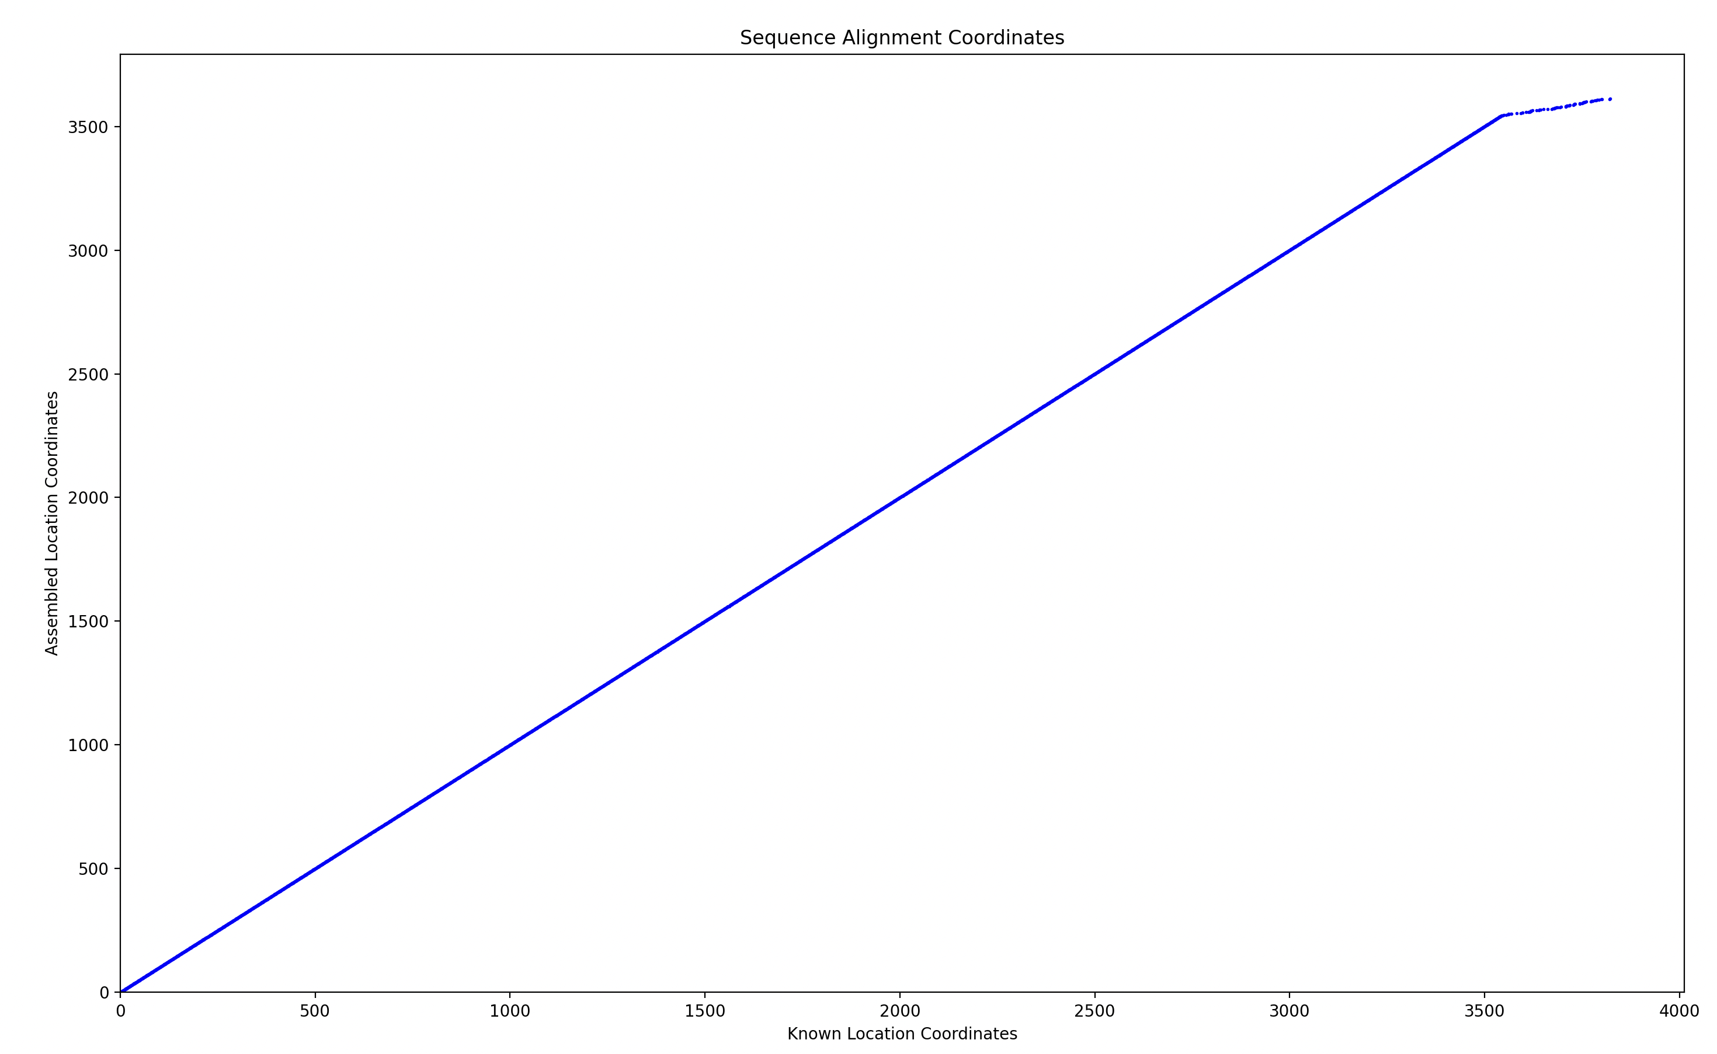
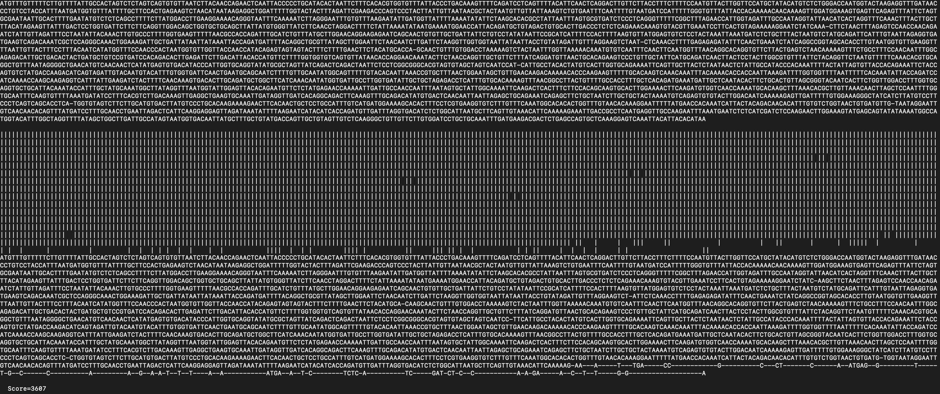
Workflow
Alignments of the contigs
Contig1: The first 3500+ bps are aligned very well

Slide 10
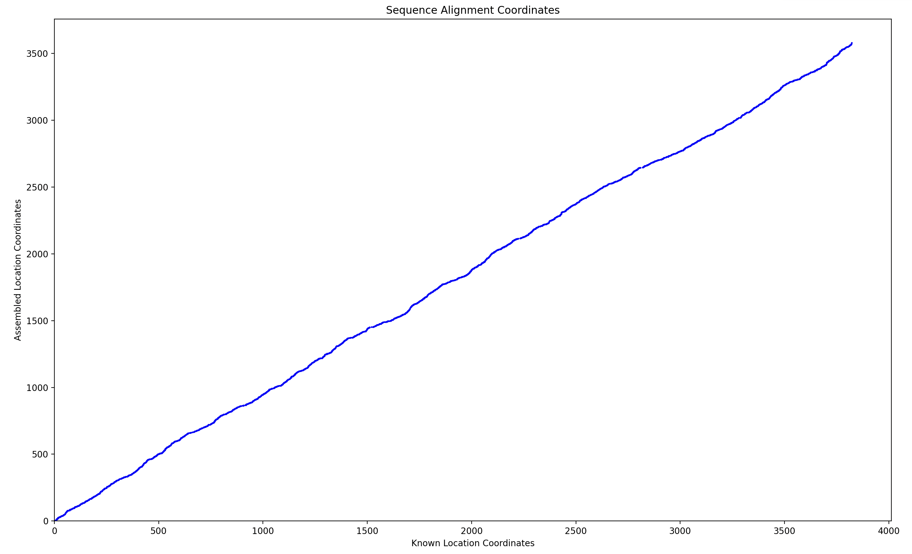
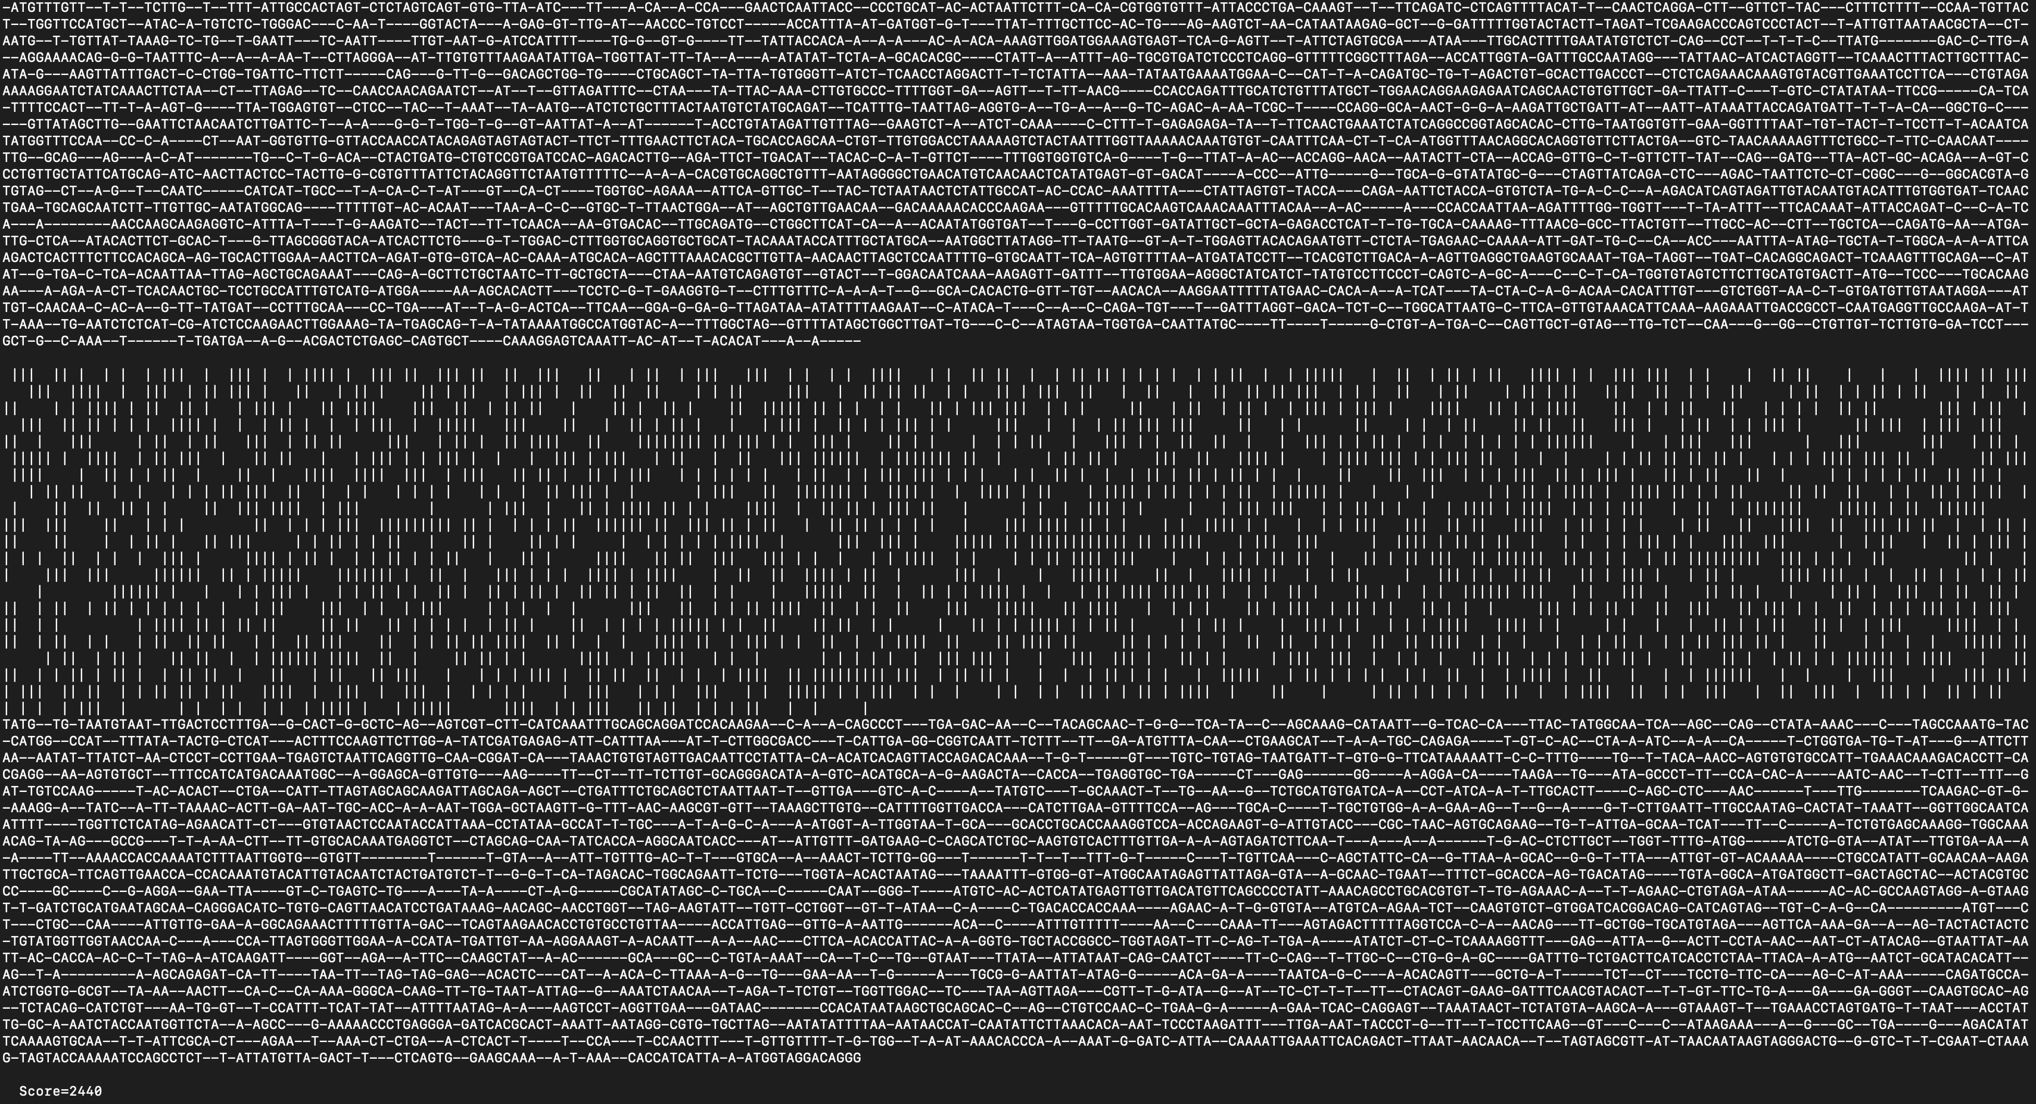
Workflow
Alignments of the contigs
Contig2: Looks like a different genome

Slide 11
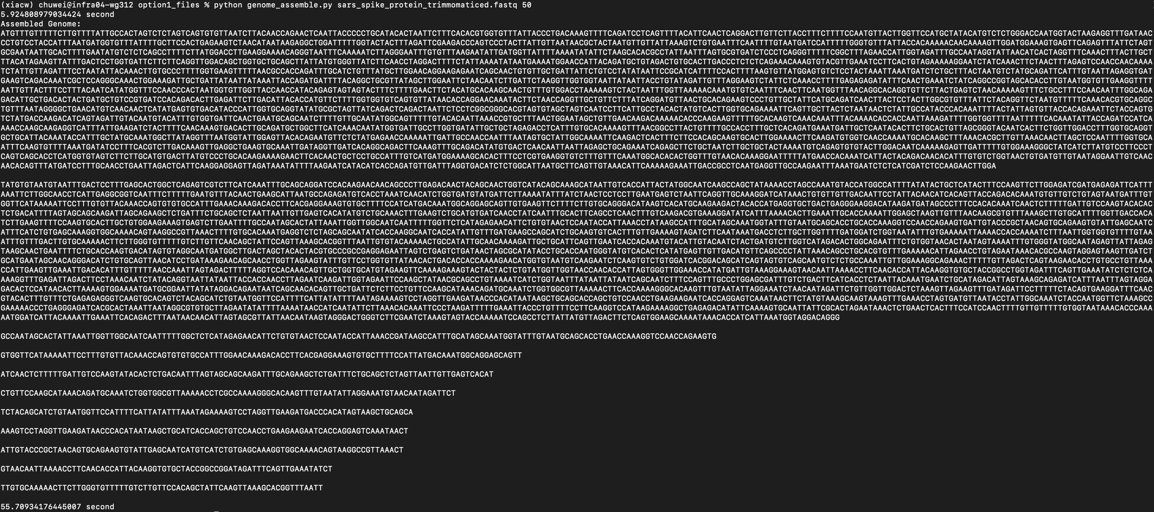
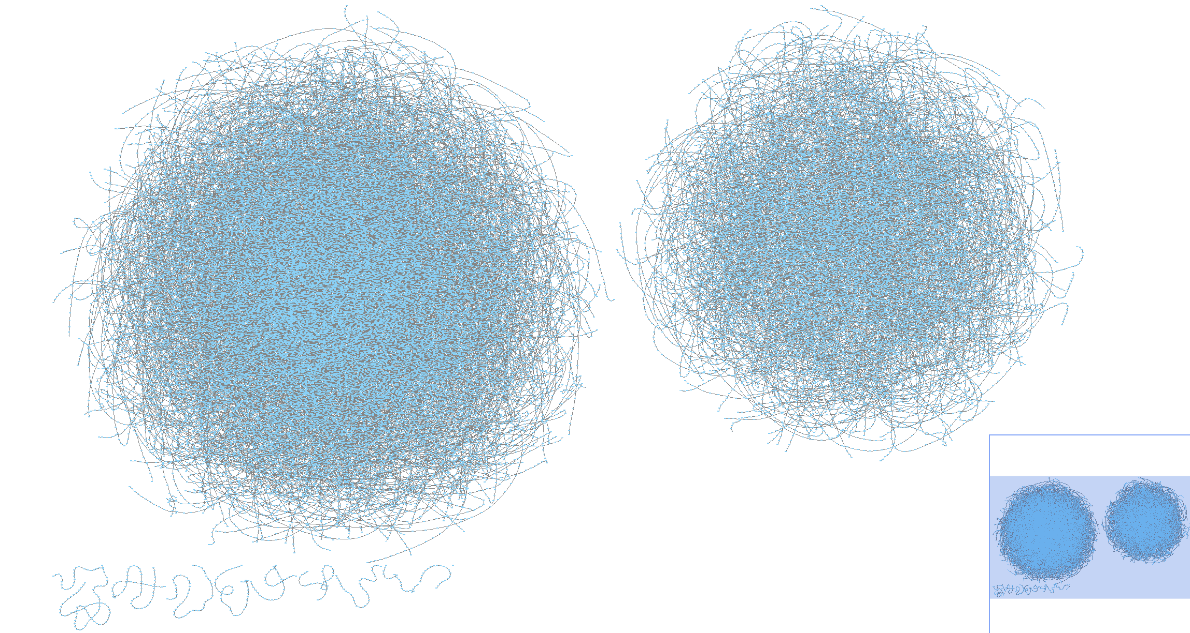
Workflow
Genome assembly (kmer = 50)
Applied algorithm: DFS, taken.

Slide 12
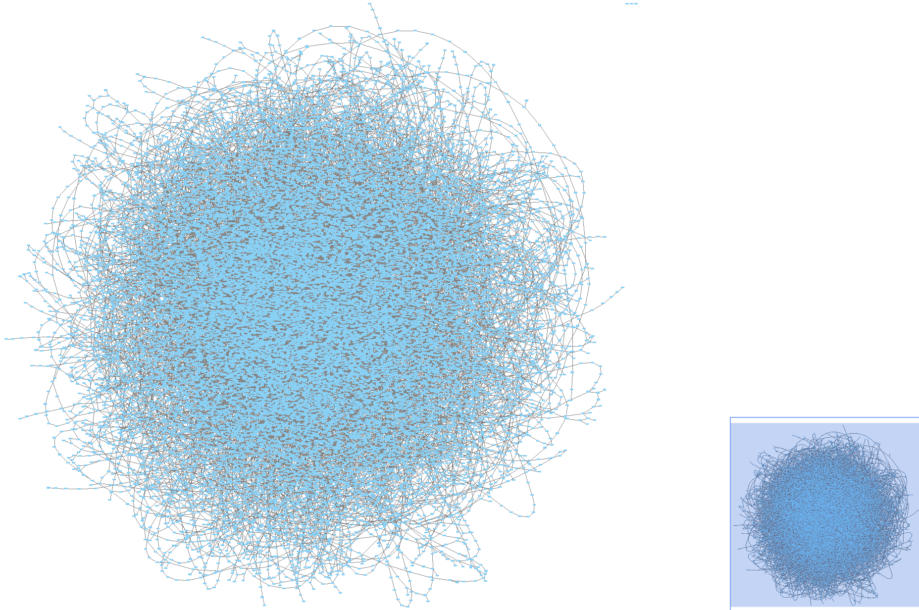
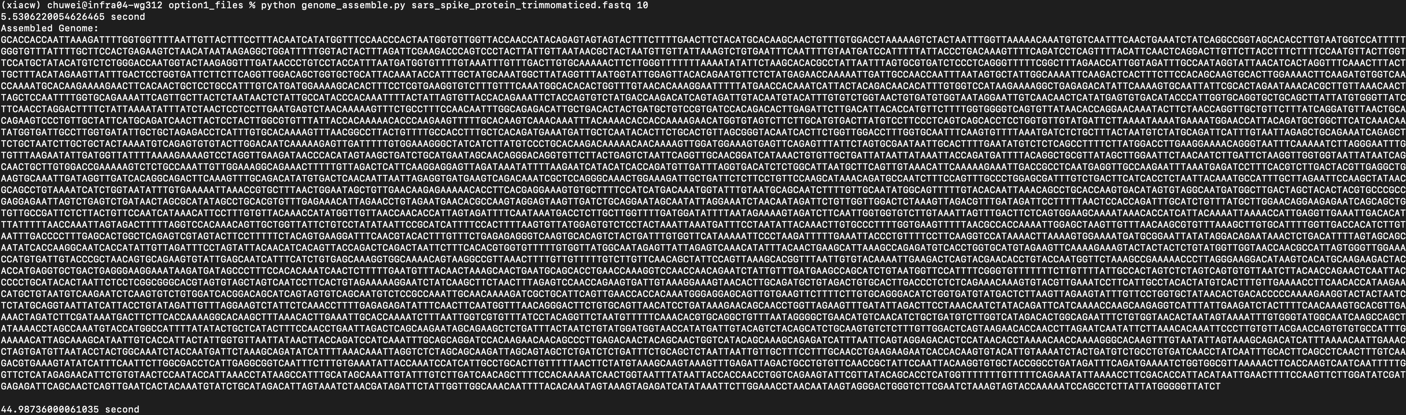
Workflow
Genome assembly (kmer = 10)
Applied algorithm: DFS, taken.

Slide 13
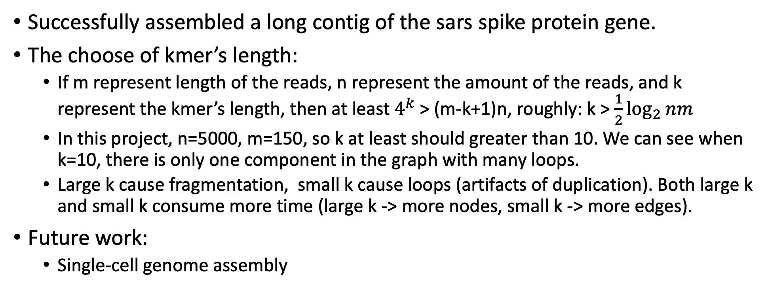
Conclusion
Successfully assembled a long contig of the sars spike protein gene.
The choose of kmer’s length:
If m represent length of the reads, n represent the amount of the reads, and k represent the kmer’s length, then at least $4^{k}$ > (m-k+1)n, roughly: k > $\frac{1}{2}\log_{2}{nm}$
In this project, n=5000, m=150, so k at least should greater than 10. We can see when k=10, there is only one component in the graph with many loops.
Large k cause fragmentation, small k cause loops (artifacts of duplication). Both large k and small k consume more time (large k -> more nodes, small k -> more edges).
Future work:
Single-cell genome assembly
Notes:
This is under the worst assumption that each k-mer is uniq, and there are only 4 to the power of k kinds of kmers in total.

Slide 14
Code availability
The scripts for Final project can be found under my Github repo CSCI5481: https://github.com/blastchinchillas/CSCI5481.git
Notes:
This is under the worst assumption that each k-mer is uniq, and there are only 4 to the power of k kinds of kmers in total.

